Slide 1




Module 3: Critical thinking and ethical decision-making in CVET
This project has been co-financed with support from the European Commission's ERASMUS+ programme. This publication reflects only the views of its authors, and neither the European Commission nor SEPIE can be held responsible for any use that may be made of the information contained herein.

Slide 2


UNIT 1: EVALUATE DECISIONS BASED ON ARTIFICIAL INTELLIGENCE AND UNDERSTAND THEIR EDUCATIONAL IMPACT
1
UNIT 2: RECOGNIZING AND ADDRESSING ETHICAL CHALLENGES IN THE USE OF AI IN THE CLASSROOM
2
CONTENTS
UNIT 3: APPLICATION OF ETHICAL REASONING MODELS IN TRAINING AND EVALUATION SITUATIONS
3
UNIT 4: STRENGTHENING DIGITAL AND MEDIA LITERACY FOR THE CRITICAL EVALUATION OF AI
4

Slide 3

LEARNING OBJECTIVES
Upon completion of this module, participants will be able to:
1
Critically evaluate the educational impact, recognizing when algorithmic recommendations meet training objectives and when they may be pedagogically inadequate or biased.
2
Recognize and address the limitations of artificial intelligence. Identify bias, hallucinations, and misinformation as structural features, rather than occasional errors.
3
Use deontological, care-based approaches when AI supports decisions in assessment, guidance, and personalization.
4
4
Interpret, verify, and critically evaluate AI-generated information and recommendations before using them in education.
5
Maintain human oversight and professional accountability. Ensure you remain ultimately responsible for the decision and the ethical guarantor, applying professional judgment that no algorithm can replicate.
Notes:
3

Slide 4

INTRODUCTION
Artificial intelligence is playing an increasingly important role in education and training. As a CVET trainer, you may already be using AI tools to support content creation, learning activities, assessment, or administrative tasks. Understanding how to use these technologies responsibly is becoming an increasingly important professional skill.
In this module, you will explore how to apply critical thinking and ethical decision-making to the use of AI in educational contexts. You will reflect on aspects such as the analysis of AI-generated information, the assessment of risks and benefits, professional responsibility, and the impact of technological decisions on students and educational practice.
The goal is not simply to learn about AI tools, but to develop the knowledge and judgment necessary to critically evaluate the use of AI and make informed and ethical decisions in continuing professional development.
Notes:
4

Slide 5

INTERNATIONAL ETHICAL FRAMEWORKS
  UNESCO Recommendation on the Ethics of Artificial Intelligence (2021)
A non-binding global ethical framework adopted by UNESCO's 193 member states. It emphasizes that AI must respect human rights, serve the common good, and be subject to human oversight. In education, this means that AI tools must support equitable access, protect student privacy, and ensure that technology enhances, rather than replaces, human pedagogical judgment.
  2. European Union AI Act (2024)
  The first comprehensive law regulating artificial intelligence. It establishes risk-based requirements for transparency, security, and the protection of fundamental rights. For education systems, it emphasizes the need for human oversight in high-impact decisions and accountability mechanisms to redress harm.

Slide 6
INTERNATIONAL ETHICAL FRAMEWORKS
3. General Data Protection Regulation (GDPR)
The European privacy framework applies to any system that processes personal data. In the field of vocational training, this implies clear consent for the use of data, transparent data governance, and the right to refuse automated decision-making that has legal consequences for employment or access to training.

Slide 7

UNIT 1:
EVALUATE DECISIONS BASED ON ARTIFICIAL INTELLIGENCE AND UNDERSTAND THEIR EDUCATIONAL IMPACT

Slide 8

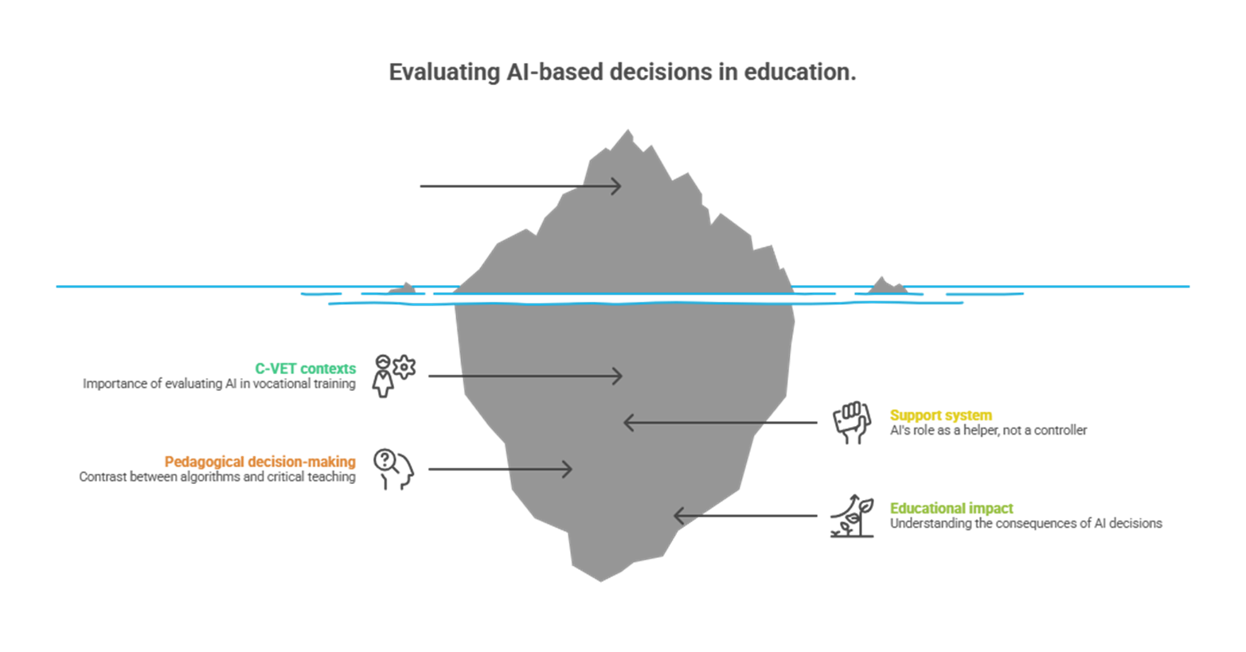
At the end of this course, as a Continuous Vocational Training trainer, you will be able to critically evaluate a recommendation generated by artificial intelligence, distinguishing its support function from its final responsibility in decision-making, and predict its educational impact on adult learners in vocational training for employment environments.
This unit introduces you to the evaluation of AI-supported decisions as probabilistic processes, which are neither neutral nor objective.

Slide 9

AI IN CVET CONTEXTS: WHY EVALUATE DECISIONS?
In CVET, AI is increasingly used to support assessment, guidance, curriculum personalization, and educational feedback. While these technologies offer new opportunities for efficiency, they do not make educational decisions autonomously.
AI works with historical data and statistical models that generally produce probabilistic results; therefore, it does not understand the educational context, does not address moral discourse, and is not responsible for the information it produces.
As UNESCO stated, AI must be human-centered: professional judgment, educational values, and ethical responsibility still belong to educators.
In vocational training systems for employment, critical thinking is necessary for:
  interpret and verify AI recommendations;
  assess its implications for equity, inclusion and student rights.
  As a trainer, you are urged to ensure that pedagogical decisions are not influenced by AI information.
Artificial intelligence supports educational decisions, but it doesn't replace human judgment; its results are probabilistic, not objective. Educators must critically interpret them and evaluate them ethically before making final decisions.

Slide 10
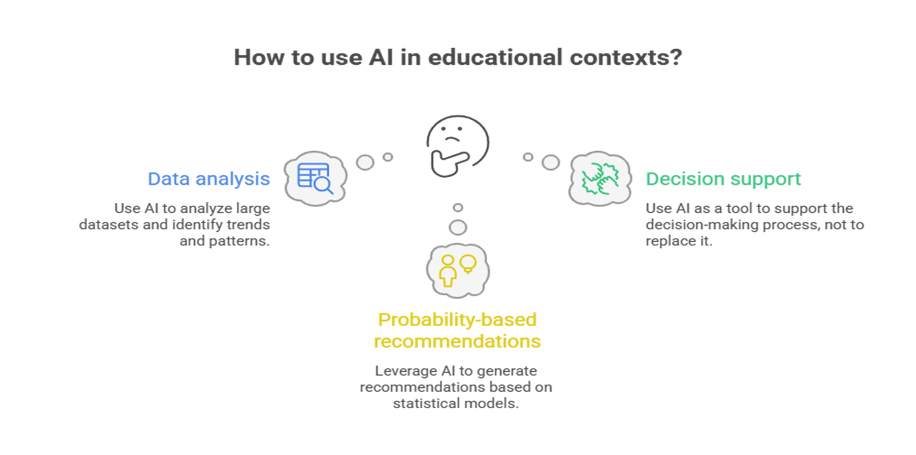
AI AS A SUPPORT SYSTEM, NOT AS A DECISION-MAKING SYSTEM
There is now a dividing line between algorithmic support for AI and CVET trainers’ pedagogical decisions. In our training programs, AI should not make decisions on its own; rather, it should analyze datasets to offer suggestions based on statistical probability. While a system may identify a trend or propose a specific learning path, we must remember that these are technical hypotheses, not pedagogical decisions.
How to use artificial intelligence in educational contexts?
AI suggestions are data-driven indications, not decisions; it is necessary to evaluate them critically and make the final pedagogical decision.

Slide 11
Real teaching focuses on the individual in front of us, considering their history, their ibstacles, and their particular learning environment
This is a responsibility that only a human being can assume. It is precisely here that your professional value as a trainer becomes evident. It lies in the ability to interpret AI suggestions, integrating that data with an understanding of the educational relationship to guarantee equity and the protection of our students.
After all, literature reminds us that AI acts as a statistical mirror of the past. It has no personal intentions, doesn't understand human values, and can never assume moral responsibility for a student's future. It is you, as the educator, who makes the final decision and is responsible for the consequences of that choice.
AI recommendations are data-driven recommendations, not decisions; they need to be critically evaluated and the final pedagogical decision made.

Slide 12
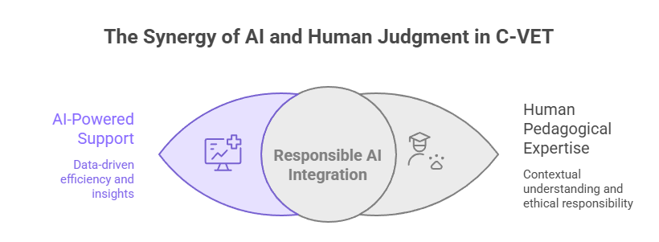
ALGORITHMIC RECOMMENDATION VERSUS CRITICAL PEDAGOGICAL DECISION
It is essential to recognize the substantial difference between automatic suggestion and pedagogical choice.
In the context of CVET, artificial intelligence systems do not make educational decisions; rather, they generate algorithmic recommendations. These recommendations are generated by analyzing historical data and statistical models that identify probabilistic correlations. In practice, AI suggests what has worked in the past in similar situations.
This means that AI can propose learning paths, activities, or resources considered "appropriate," but without understanding their pedagogical significance.
Algorithms are unaware of real-world context, do not understand educational intentions, do not assess individual needs, and lack values ​​or moral judgment. Their logic is statistical, not pedagogical.
Human pedagogical experience
Contextualized understanding and ethical responsibility

Slide 13
Pedagogical decision-making, on the other hand, is a human professional act. CVET trainers integrate information that AI cannot interpret: learning objectives, the student's history and situation, cognitive and emotional dimensions, as well as principles of equity, inclusion, and educational responsibility.
For this reason, the main international guidelines emphasize that AI should be used as a support tool, never as a substitute for professional judgment. An uncritical use of algorithmic recommendations can, in fact, reinforce biases, strengthen inequalities, and generate decisions that may appear efficient but are pedagogically inadequate. The role of the Continuous vocational education and training (CVET) educator is, therefore, that of a critical mediator: to question the recommendations generated by AI, evaluate their educational impact, and assume ultimate responsibility for decisions that affect students' pathways and opportunities.
AI recommendations are data-driven recommendations, not decisions; they need to be critically evaluated and the final pedagogical decision made.
Notes:
13

Slide 14
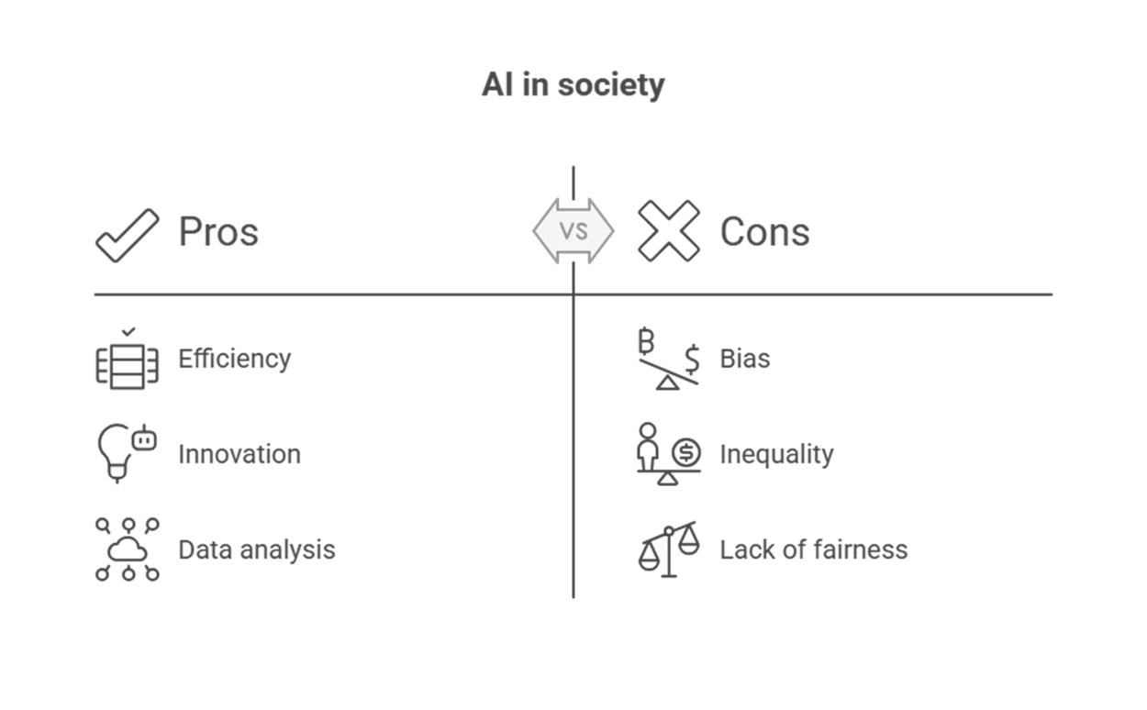
EDUCATIONAL IMPACT OF AI-SUPPORTED DECISIONS
AI in society
As a CVET trainer, it's important to consider the educational and ethical consequences of AI-driven decisions. Artificial intelligence can provide valuable support to educational processes, but every use of AI has tangible effects on student learning and opportunities.
For this reason, AI-supported decisions are never educationally neutral. On the one hand, AI can expand access to education, help personalize learning pathways, and provide rapid and targeted feedback, particularly useful in vocational training contexts characterized by time constraints and high student diversity. On the other hand, if used without critical oversight, AI can generate educational and ethical risks.

Slide 15

A primary risk relates to fairness. Algorithms learn from historical data that may contain biases or structural imbalances. If a trainer ignores the recommendations, the information provided by AI can be detrimental to certain groups and exacerbate existing inequalities with assessments that appear impartial and objective but are, in reality, unfair.
Another criticism is the lack of transparency, as many AI systems act as a "black box" because it's not always clear how certain recommendations will be generated. This prevents them from analyzing decisions, participating in critical discussions with students, and building trust in education systems.
International guidelines continue to recommend the responsible use of AI in education. Therefore, educational decisions must be explained and aligned with pedagogical objectives.
AI should only support the work of the teacher, since the teacher is the only responsible educator.
Test your knowledge
Notes:
15

Slide 16
UNIT 2:
RECOGNIZING AND ADDRESSING ETHICAL CHALLENGES IN THE USE OF AI IN THE CLASSROOM

Slide 17
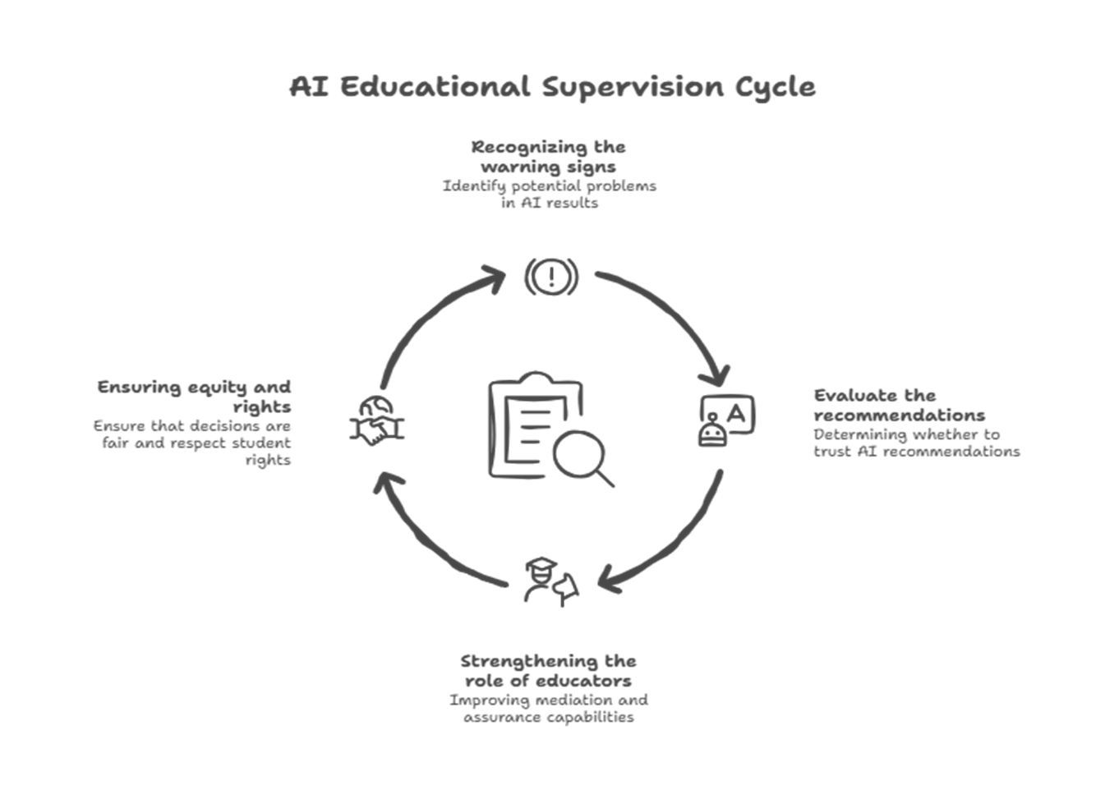
As a vocational training instructor, you must understand the structural limitations of artificial intelligence systems, which are often barely perceptible, but have a significant educational impact on activities such as guidance, personalization of training programs, assessment, and feedback.
Through short units, the module will help you to:
recognize biases that may influence assessments and recommendations;
identify hallucinations, that is, those parts of AI-generated content that seem plausible but are actually incorrect or fabricated;
understand why AI lacks awareness of values ​​or understanding of the educational context;
distinguish between reliable information and algorithmic disinformation, especially when AI is used without critical review.

Slide 18
STRUCTURAL LIMITATIONS OF AI SYSTEMS IN CVET
Sometimes, structural limitations affect the quality and equity of educational decisions. These limitations are not isolated errors, but rather depend primarily on how artificial intelligence is used and trained. Artificial systems do not understand the educational context, analyze personal situations, or consider values ​​as a teacher would.
They work by calculating statistical probabilities from large amounts of historical data.
Technically, AI identifies more frequent correlations, but it does not reason based on intentions, training objectives, or responsibilities.
AI has structural limitations: it relies on historical data and probabilities without understanding the context, which can lead to biases and hallucinations.

Slide 19

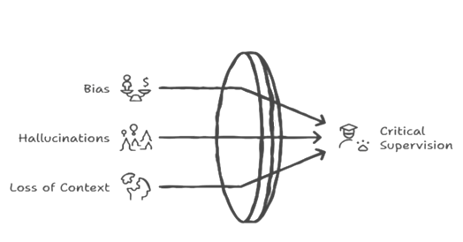
This creates unavoidable limitations:
AI provides data that may contain biases depending on the data that has been used to train the model.
It provides more likely data.
It is unaware of the student's situation and behavior, especially in relation to the classroom context.
It is incapable of verifying the facts or comparing them with reality.
Therefore, anomalies such as distortions, hallucinations, and loss of context are not system defects, but normal effects of AI operation.
In CVET, this makes critical supervision of the trainer indispensable, since he remains solely responsible for educational decisions.
Notes:
19

Slide 20
WHAT IS BIAS AND HOW TO RECOGNIZE IT CVET?
A bias is a systematic distortion in the results produced by an artificial intelligence system.
The bias favors certain groups even when the data appears neutral. This is not an isolated error, but rather an anomaly that develops over time due to repeated use of the system. Technically, these biases result from the system's training, which "learns" from historical data, transforming past patterns into predictive criteria.
Algorithmic bias arises from the interaction between data, the model, and the context: since training data may contain historical inequalities, AI outcomes can systematically favor or penalize certain groups, making oversight by the trainer essential.

Slide 21
If these data reflect social inequalities, stereotypes, or discriminatory practices, the model reproduces or amplifies them, treating them as if they were "normal" or "objective" (Barocas, Hardt, and Narayanan; O'Neil).
In the context of CVET, this can lead to incorrect learning recommendations, unfair selection criteria, and inappropriate assessments: the system tends to exclude rather than include.
These decisions, individually, may seem harmless, but over time and cumulatively, they create invisible barriers that conflict with the principles of equity and inclusion in continuing professional development.
The bias arises from the interaction between the data, the model, and the context. The algorithm acts as a statistical mirror of past reality, without the possibility of questioning it.

Slide 22
HALLUCINATIONS: WHAT THEY ARE AND HOW TO RECOGNIZE THEM IN CVET CONTEXTS
In generative AI systems, "hallucination" refers to situations in which the AI ​​produces seemingly correct, well-written, and convincing responses, but which contain false, inaccurate, or unverifiable information.
In reality, AI does not know for sure if what it says is true, since its operation is based on statistical calculations: the system selects the words most likely to combine with others and does not analyze the facts.
These results will be very likely in form, but incorrect in content.
In the context of vocational training for employment, this is especially serious, as it can affect instructional design, skills assessment, student response, and guidance decisions.
AI-generated hallucinations occur when systems produce information that is plausible yet factually incorrect, based on probabilistic patterns rather than verified knowledge, which can pose educational risks and necessitates critical verification and human oversight by the instructor.

Slide 23
LACK OF UNDERSTANDING OF VALUES AND CONTEXT
AI is not truly intelligent because it does not fully understand what it processes.
It is incapable of interpreting individuals or complex educational situations, instead relying on statistical correlations between data observed during its training. As we have seen previously, when an artificial system produces data, a recommendation does not address the specifics of the situation as a trainer would, but rather generates a probable outcome that is often pedagogically inappropriate.
In CVET contexts where the subjective component plays a crucial role, the system can analyze similar profiles that have produced similar results, but it can never explain why it generated a particular statistical result. This can be useful as a starting point, but if not interpreted, it carries the risk of exclusions and unfair decisions.

Slide 24
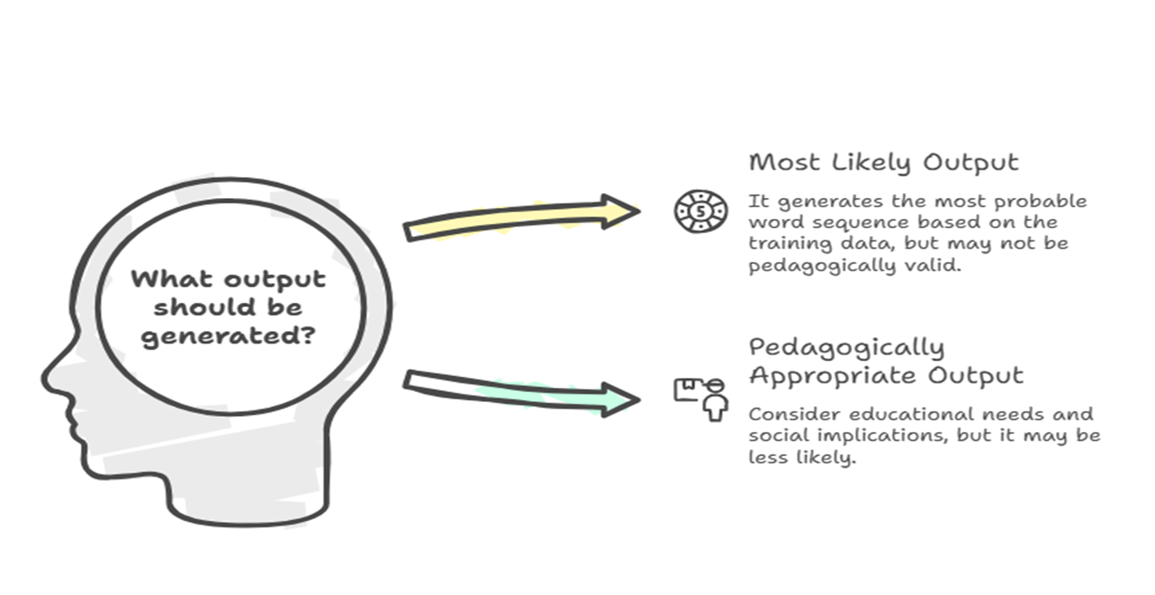
Even when you provide more information through personalized and timely attention, artificial intelligence only receives descriptions, not pedagogical judgment.
Evaluating AI information is a task that requires exclusively human skills: knowledge of the real-world context, the educational relationship, and professional responsibility.
The value of a teacher lies in their ability to integrate technology with pedagogical judgment.

Slide 25

DISINFORMATION AND NON-CRITICAL USE OF AI
It is important to understand artificial intelligence as a tool that is not responsible for deciding whether information is true or false; this responsibility always falls on human beings.
Several studies have shown that misinformation spreads mainly when users do not critically analyze sources and automated results, regardless of the technical quality of the system (Wardle and Derakhshan, 2017; Nyhan and Reifler, 2010).
In educational systems, there is a risk of accepting valuable and well-written information when trainers and students accept it without a critical spirit.

Slide 26
Without digital and media literacy, the results of artificial intelligence can be used uncritically to design learning activities, assess skills, or conduct evaluations.
We shouldn't blame only artificial intelligence, as it is a useful and, in some ways, indispensable tool.
What we must emphasize is the interaction between technology and users, who, especially if they are educators, cannot avoid becoming critical mediators who verify information and promote active control practices.
Disinformation should be combated by strengthening critical thinking skills, verifying sources, and fostering metacognitive reflection, rather than introducing new technological tools.
Test your knowledge

Slide 27
UNIT 3:
APPLICATION OF ETHICAL REASONING MODELS IN TRAINING AND ASSESSMENT SITUATIONS

Slide 28
The unit focuses on the application of ethical reasoning models that can be implemented in CVET, where decisions will impact skills assessment programs, career guidance, and job training opportunities.
Through realistic examples, you will learn that educational decisions are never neutral; artificial intelligence, in addition to being a solution, increases your responsibility as a trainer; and ethics will never be a set of rules to follow, but a process of contextualized evaluation.
The concept of the trainer as a critical mediator is reinforced with this module, as it will integrate algorithmic results, knowledge of the real context, educational relationships, and the values ​​of equity, inclusion, and human protection.
When consulting artificial intelligence, as an educator, you may perceive an increase in your responsibility. However, by applying ethical reasoning models, AI can be transformed from a potential risk into a responsible, fair, and human-centered educational tool.

Slide 29
EDUCATIONAL DECISIONS AND ETHICAL RESPONSIBILITY OF THE TRAINER
A trainer’s educational decision is never neutral or technical.
Its actions always have an ethical, social, and normative character, as they impact learning opportunities, guidance, and career paths. In these contexts, where artificial intelligence is integrated into the evaluation, personalization, and training processes, it is essential to clearly distinguish between algorithmic support and pedagogical decisions.
As already mentioned, AI processes data and produces probabilistic results (recommendations, suggestions, information, classifications), but it never makes educational decisions.
It lacks semantic understanding and awareness of educational values, as it does not interpret the pedagogical, cultural, or social meaning of educational situations.
Only the trainer can integrate: AI indications, knowledge of the real context, the student's individual history, the educational relationship, and the principles of equity and inclusion.
Educational decisions have real consequences for students’ opportunities and rights; while AI can provide probabilistic analytical support, the ethical responsibility and professional judgement required to integrate data, context, and educational values always rest with the trainer.

Slide 30
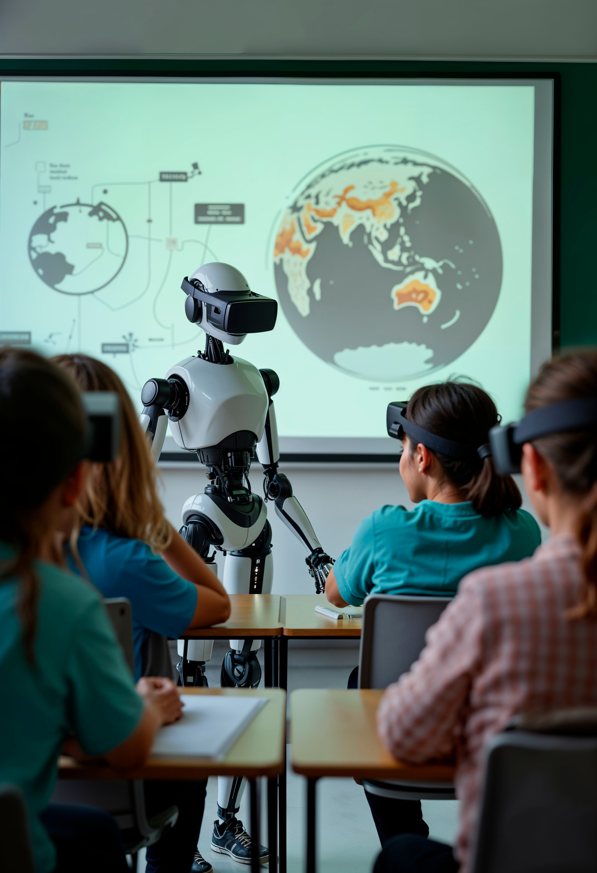
MODELS OF ETHICAL REASONING APPLICABLE TO THE CVET
In education, including CVET, AI-supported decision-making requires knowledge that goes beyond simple technical evaluation.
The decision-maker, usually the trainer, must formulate a structured ethical argument, keeping in mind that the tool only provides algorithmic results and that decisions must consider subjective circumstances such as rights, consequences, responsibilities, and educational values. To manage this process, trainers should draw on established models of ethical reasoning.

Slide 31

  The ethical model allows us to assess whether a decision respects fundamental rights and ethical principles such as fairness, non-discrimination, and transparency. Applying this model to artificial intelligence raises the question of whether an automated recommendation treats students consistently.
  The consequentialist model focuses attention on the concrete effects of decisions: What impact does a recommendation have on access to the course, motivation, or the risk of exclusion? Even unintended consequences become relevant.
  The ethics of care, applied to education, focuses attention on the learning relationship and the individual history of the student. Herein lies the structural limitation of AI: its inability to capture personal vulnerabilities, life transitions, and non-formalizable data.
  The accountability model clarifies that, even when decisions are supported by artificial intelligence, professional responsibility rests with the AI ​​trainer, that is, a human being.
  Artificial intelligence does not function as an ethical substitute, a tool for demanding accountability for decisions, even if they are wrong. It can support and assist educators in clarifying the reasons for their choices and strengthening the ethical quality of their decisions, even with AI support.

Slide 32
ETHICAL REASONING IN THE USE OF AI FOR ROUTE GUIDANCE AND PERSONALIZATION
In the context CVET artificial intelligence systems are increasingly used to guide students and personalize their learning pathways, for example, bysuggesting courses, access levels, or skills development trajectories.
It is widely demonstrated that artificial intelligence is increasingly used in vocational training systems to develop courses, personalize learning, define access levels and professional skills development pathways.
This professional information is of utmost importance given its purpose. However, considering that all this information is generated from historical data and probabilistic calculations, without evaluating its educational, social, or ethical value, it is evident how inappropriate it is to delegate the educational future of students to artificial intelligence.
AI-assisted guidance provides probabilistic recommendations rather than educational decisions; educators must apply ethical principles, such as protecting rights, assessing long-term effects, and prioritizing the educational relationship, while retaining ultimate responsibility for decisions.

Slide 33
Algorithmic results cannot fully address individual situations, which are influenced by an infinite number of variables. Only a person can do this, and they can help make decisions supported not only by artificial intelligence, but also by critical and ethical skills aimed at expanding options for the common good.
Guidance must be fair and respect students' rights. An algorithmic decision that limits access to courses for certain groups violates the professional principles of Vocational Training for Employment.
A consequentialist approach leads us to consider the long-term effects: effective guidance has positive employment-related benefits. The ethics of care remind us that guidance is an educational relationship. As a trainer, you become central to the learning process about the student and the most appropriate application of algorithmic principles.
Guidance requires that you remain the one who makes the final decision, taking advantage of artificial intelligence and being able, at the same time, to transform automated recommendations into fair and contextualized pedagogical options.

Slide 34
THE TRAINER AS A CRITICAL MEDIATOR OF ALGORITHMIC DECISIONS
Your responsibility is reinforced by the use of artificial intelligence. Since the algorithm never makes educational decisions on its own, the responsibility for institutional ethical standards still rests with humans at multiple levels.
  The first level of responsibility is supervision. This involves understanding the tool used, at least in general terms, how it works, and the factors that influence its recommendations. From there, it is possible to identify any structural limitations that may arise. This capacity for general supervision allows for suspending or completely discarding algorithmic recommendations when they are incompatible with the educational context.
  The second level is verification and potential correction. The algorithmic information from AI used for guidance, assessment, certification, and other purposes must be critically reviewed before use. In this case, artificial intelligence doesn't determine the decision but rather supports it, which gives you considerable leeway for validation.
  The ultimate concept is the principle of accountability, according to which all decisions are explainable and traceable. If a decision supported by artificial intelligence has a negative impact on the learning process or the student, the responsibility always rests with you as the educator.
  Your educational role as a trainer is that of a human guarantor who assumes full responsibility for pedagogical decisions, even when these are supported by artificial intelligence tools.
Test

Slide 35
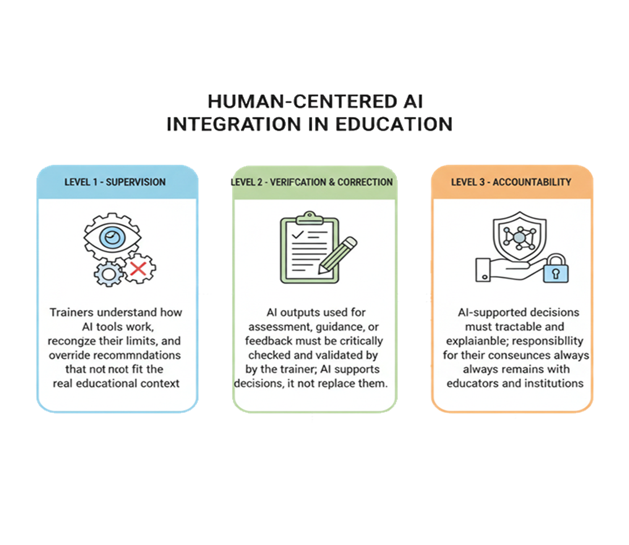
AI is not a moral or decision-making subject therefore trainers must exercise human responsibility through critical oversight, verification of outputs, accountable decisions, and the integration of technology with contextual and pedagogical judgement.

Slide 36
UNIT 4:
STRENGTHENING DIGITAL AND MEDIA LITERACY FOR THE CRITICAL EVALUATION OF AI

Slide 37

Digital and media literacy is not about depending more on AI, but about trusting more in one's own professional judgment.
In line with the above, this unit complements the previous information and, after analyzing decisions, ethical models, and biases, focuses on the cross-cutting competence of applying knowledge in daily practice. Digital and media stabilization becomes a fundamental competence for ethical judgment, not an accessory one.
In this context, the development of digital and media literacy applied to AI systems, in its various forms, is understood not as a specialized technical competence, but as a professional and critical capacity for the trainer of CVET.
  Consciously understand the information provided by AI.
  Distinguish when it is about information, advice, or educational decision-making.
  Knowing when and how to assume the role of critical mediator between technology and educational processes.

Slide 38
UNDERSTANDING HOW AI "THINKS"
To use Artificial Intelligence responsibly in CVET, you must understand how AI systems work and what their limitations are. Most of the tools used in education (automated assessments, adaptive systems, chatbots, text-based feedback) are based on statistical machine learning models. These systems analyze large amounts of data and produce probabilistic responses, that is, statistically plausible results, not necessarily correct or informed.
It's important to remember that AI doesn't truly understand the meaning of content: it operates through mathematical correlations between words and data, without interpreting educational values, context, or intentions. Therefore, a well-formulated answer doesn't imply pedagogical understanding.
AI generates probabilistic outputs without semantic understanding and often with limited transparency, while trainers interpret context, history, and learner needs, making pedagogical judgement an exclusively human responsibility.

Slide 39
In contrast, a human trainer evaluates by considering:
The educational context
The professional experience of the participants
The Individual difficulties
The learning objectives
The criteria of equity and educational appropriateness
Furthermore, as mentioned in previous units, many AI systems function as a "black box," meaning that it is not always clear why they produce a particular recommendation or response.
For this reason, your critical oversight as a trainer is essential: only you can assess whether the AI ​​results are truly appropriate from a pedagogical standpoint. AI can support the training process, but it does not replace your pedagogical judgment.

Slide 40
EVALUATE THE RELIABILITY OF INFORMATION GENERATED BY AI
In CVET settings, AI systems are increasingly used to generate content, provide feedback, and support learning guidance. However, it is crucial to remember that AI does not verify the accuracy of information; rather, it produces texts based on linguistic probabilities and available data.
For this reason, seemingly complete and convincing answers may be inaccurate, incomplete, or outdated. As we learned in Unit 2, this phenomenon is known as "hallucinations."
To use AI responsibly, it is necessary to adopt some verification strategies:
Compare sources: Consider AI responses as preliminary hypotheses and verify them with institutional documents, professional standards, scientific literature, or official regulations.
Check the citations: the absence of clear sources or references can be a sign of risk.
Recognizing possible hallucinations: very fluent and confident, but generic and unsourced answers should always be verified.
Check for completeness and currency: AI models may not include regulatory changes or recent developments.
AI can support training efforts, but critical thinking and information verification remain the responsibility of the trainer.
AI generates plausible but not necessarily verified information, which may include hallucinations our outdated content. Educators must compare sources, consider context, and critically validate outputs before using them for educational purposes.

Slide 41
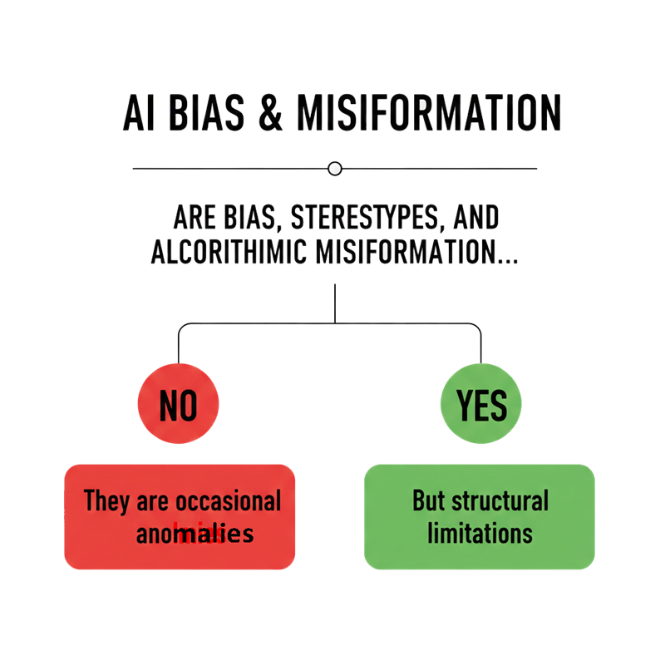
ALGORITHMIC DISINFORMATION
Another risk you can't lose sight of is algorithmic misinformation, which occurs when AI generates inaccurate, simplified, or misleading content, prioritizing statistical consistency over the truth.
Some warning signs may include:
  Results that repeatedly harm the same groups
  Unclear evaluations or classifications
  Recommendations that ignore the individual development of the student
Research shows that bias depends not only on the algorithm, but also on the interaction between the data, the model, and the context of use. Your critical oversight as a trainer is essential to identify biases and evaluate the pedagogical suitability of the results generated by AI.

Slide 42

Applying media literacy to Artificial Intelligence involves developing the ability to critically interpret content produced or mediated by AI systems.
It's not just about using tools, but about understanding how to read and evaluate the information generated.

Slide 43
Proper media literacy requires a clear distinction between three levels:
  Verifiable information, which should be checked against external sources.
  Algorithmic suggestions, generated by the AI ​​system.
  Pedagogical decisions, which remain the responsibility of the educator.
The main risk is confusing these levels, interpreting an AI recommendation as a correct or definitive decision. Media literacy allows you to contextualize and critically interpret AI outcomes, while maintaining pedagogical control over decisions that affect students' learning trajectories.
AI outputs are probabilistic algorithmic mediations and not reliable sources. The distinction is between information, suggestions, and pedagogical decisions, made by educators who, by applying critical judgement, retain ultimate educational responsibility.

Slide 44


THE ROLE OF THE TRAINER AS A CRITICAL MEDIATOR
The use of Artificial Intelligence in CVET does not diminish your responsibility as an educator; rather, it makes it even more crucial. AI is not an educational agent: it is a support tool that lacks pedagogical judgment and moral responsibility.
Therefore, you must play a fundamental role as a key mediator between technology, students, and educational objectives.
Recommendations or results generated by AI should never be automatically accepted: they always need to be interpreted, contextualized, and evaluated in light of educational experience.

Slide 45
As an educator, you have a broader educational role: to promote a conscious use of AI, helping students and colleagues to develop autonomy of judgment and to overcome the idea that technology is neutral or infallible
This involves knowing how:
  Recognize and interpret information generated by AI.
  Critically evaluate the results.
  Making informed educational decisions.
  Taking responsibility for educational decisions.
  AI can support the educational process, but the pedagogical relevance of the decisions always rests with you as the educator.
The trainer acts as a critical mediator who interprets and verifies AI outputs, exercising human judgement and ensuring that educational decisions remain responsible, inclusive and guided principles of equity.
Test
Notes:
48

Slide 46
KEY IDEAS
✓ Algorithms are tools, not decision-making systems.
When used responsibly, AI can process information, identify patterns, and offer support. However, it cannot and should not replace human judgment in matters that affect educational opportunities and people's futures.
✓ Bias is not a mistake; it is a structural risk of algorithmic systems.
When algorithms learn from historical data, they learn historical patterns, including discrimination and inequality. Your role as an educator is to actively monitor AI systems for bias.
✓ Confidence in the result of an AI is not a sign of reliability.
AI systems produce fluent, well-written, and seemingly authoritative content, even when that content is partially false, outdated, or unverifiable. You must verify information and maintain a critical skepticism.

Slide 47

KEY IDEAS
✓ Transparency and accountability are non-negotiable.
Students have the right to know when algorithms are involved in decisions that affect them. Institutions that use AI in education must be transparent about their systems and maintain documented evidence that human oversight was conducted.
✓ Your professional judgment is irreplaceable.
You understand the context. You know your students. You understand the educational importance of the decisions. As artificial intelligence becomes more integrated into education, your role becomes increasingly relevant.
AI-powered content checklist

Slide 48
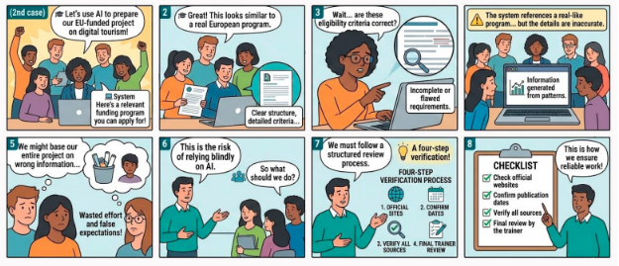
LEARNING SCENARIO
The following scenarios are real-life cases aligned with relevant EU ethical standards and regulations, as well as regulatory frameworks, ensuring their practical applicability and contextual relevance.
Access the learning environment

Slide 49
REFERENCES
AI ethics and accountability
• Dignum, V. (2019). Responsible Artificial Intelligence. Springer.
• Floridi, L., & Cowls, J. (2019). A Unified Framework of Five
• Floridi, L. (2023). AI, Agency and Responsibility. Philosophy & Technology.
Principles for AI in Society
• Mittelstadt, B. et al. (2016). The ethics of algorithms. Big Data & Society.
AI, learning and educational context
• Holmes, W., Bialik, M., Fadel, C. (2019). Artificial Intelligence in Education.
• Luckin, R. et al. (2016). Intelligence Unleashed.
• Selwyn, N. (2019). Should Robots Replace Teachers?
• Williamson, B., & Eynon, R. (2020). AI in education.
Limitations of AI (bias, opacity, misinformation)
• Barocas, S., Hardt, M., Narayanan, A. (2019). Fairness and Machine Learning.
• Bender, E. M. et al. (2021). On the Dangers of Stochastic Parrots.
• Burrell, J. (2016). Understanding opacity in ML.
• Ji, Z. et al. (2023). Hallucination in NLG.
• O’Neil, C. (2016). Weapons of Math Destruction.
Notes:
38

Slide 50
REFERENCES
Theoretical and critical foundations on AI
• Mitchell, M. (2019). Artificial Intelligence: A Guide for Thinking Humans.
• Russell, S. (2019). Human Compatible.
• Russell, S., Norvig, P. (2021). Artificial Intelligence: A Modern Approach.
• Searle, J. (1980). Minds, Brains and Programs.
Governance, policies and guidelines
• European Training Foundation (2022). AI for VET.
• OECD (2022). AI in Society.
• UNESCO (2021). AI and Education: Guidance for Policy-Makers.
• UNESCO (2022). Recommendation on the Ethics of AI.
Bias and social impact
• Eubanks, V. (2018). Automating Inequality.
• Mehrabi, N. et al. (2021). Bias and Fairness in ML.
• Noble, S. (2018). Algorithms of Oppression.
Notes:
38

Slide 51

Restart
Exit Course
This project has been co-financed with support from the European Commission's ERASMUS+ programme. This publication reflects only the views of its authors, and neither the European Commission nor SEPIE can be held responsible for any use that may be made of the information contained herein.

